Slide 1
Introduction To Deep Learning
By: Akhil Suri

Slide 2
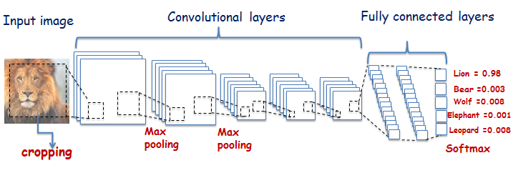
General Deep Learning Usage
Source: https://www.rug.nl/research/bernoulli/groups/autonomus-perceptive-systems/research_and_projects/phd-project_-comparative-study-between-deep-learning-and-bag-of-visual-words-for-animal-recognit?lang=en

Slide 3
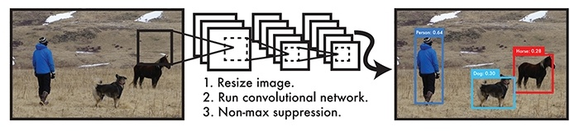
Common Deep Learning Models
Source: https://tryolabs.com/blog/2017/08/30/object-detection-an-overview-in-the-age-of-deep-learning/

Slide 4
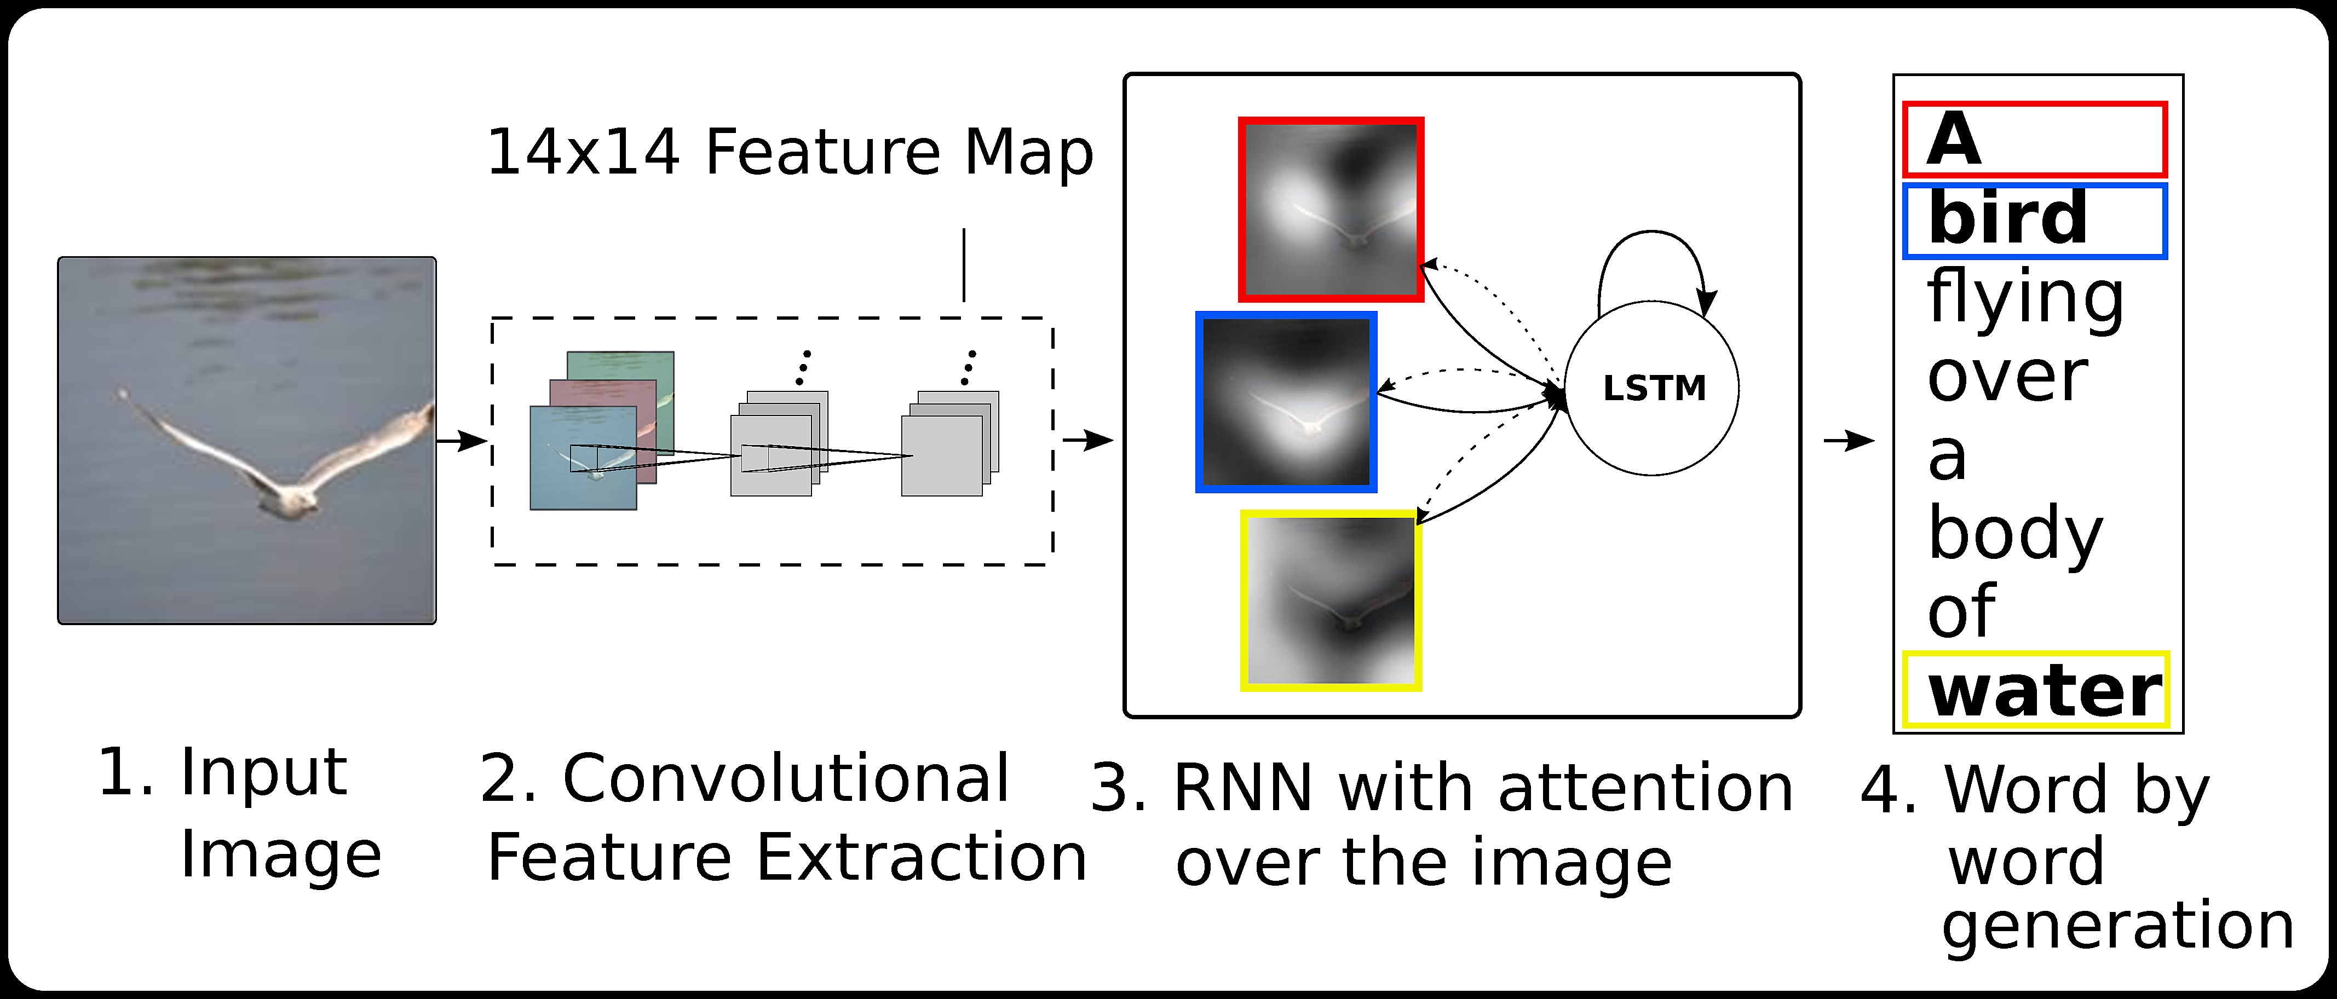
Common Deep Learning Models
Source: https://github.com/handong1587/handong1587.github.io/blob/master/_posts/deep_learning/ 2015-10-09-captioning.md

Slide 5
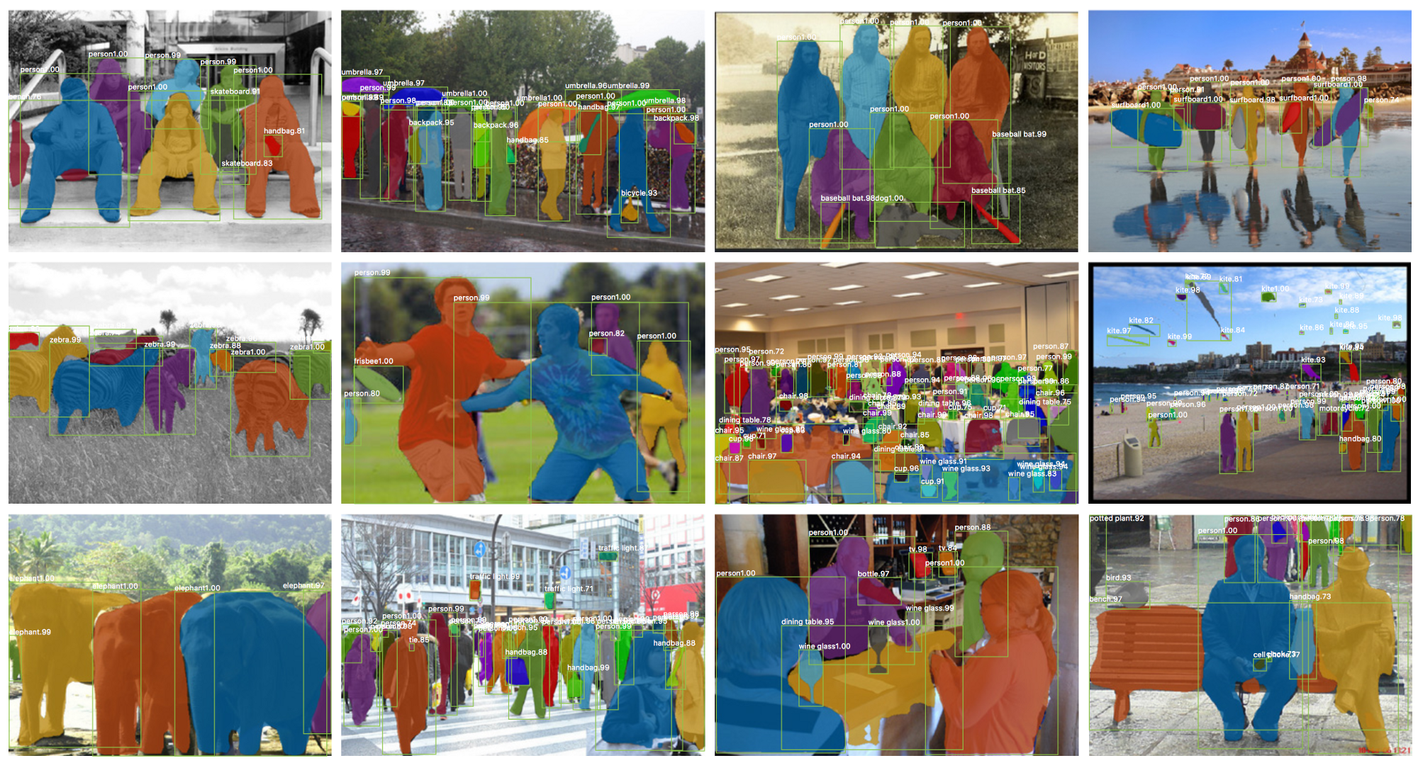
Common Deep Learning Models
Source: http://www.thothchildren.com/chapter/59b94f4a75704408bd430150

Slide 6
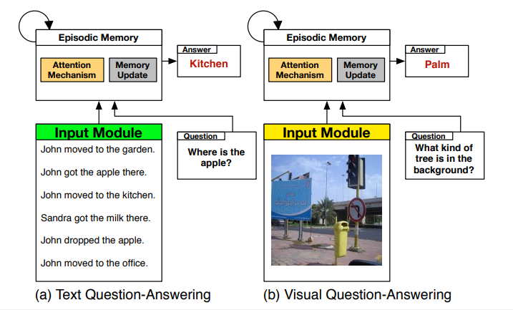
Common Deep Learning Models
Source: https://arxiv.org/pdf/1603.01417.pdf

